Slide 1
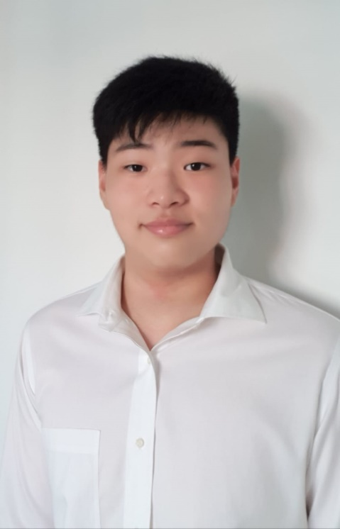
Profile
Intern Name: Kobe Chang Ze Rui
Institution : Temasek Polytechnic
Internship Period: 5 July 2020 – 30 Jan 2021
Department: Research & Development
Project & Deliverables: MTF GUI & Others

Slide 2
Purpose and Scope Project Description,
Deliverables
3. Major Achievements, Challenges and Key Learning Points
4. Special Thanks and Appreciation

Slide 3
Purpose & Scope of Projects
All Projects
Project Name | Project Purpose | Scope & Boundary
MTF GUI | Create a GUI for presenting MTF data to Engineers Determine the good / bad Lens and Wafers | Continuous Improvement Project (CIP) Improvements Design Added Features Create new / edit current configuration file Contoured / Pass fail Wafer Map Open multiple Wafer Maps with different frequencies Heat Map
PDF Image processing | Automate image processing from PDF files | Process , crop & superimpose correct images and info based on filetype
PCP & IQC Generator | Automate copying process of the PCP & IQC processes Decrease time spent on making control plan | Managing variability in number of worksheets & remarks Export new control plan csv file with IQC and PCP control plans
Test Reject GUI | Create a GUI showing operators which units on the tray need to be picked up | Find Mphase & 2DBC csv files by the given Lot & tray number Display Bin Numbers for found serial numbers in 2DBC file
Angel wings plot | Create Angel wings plot based on builds & C.A. | Plot out Angel wings by different builds & Clear aperture (90 & 99%CA) Color plot based on direction & by FEC

Slide 4
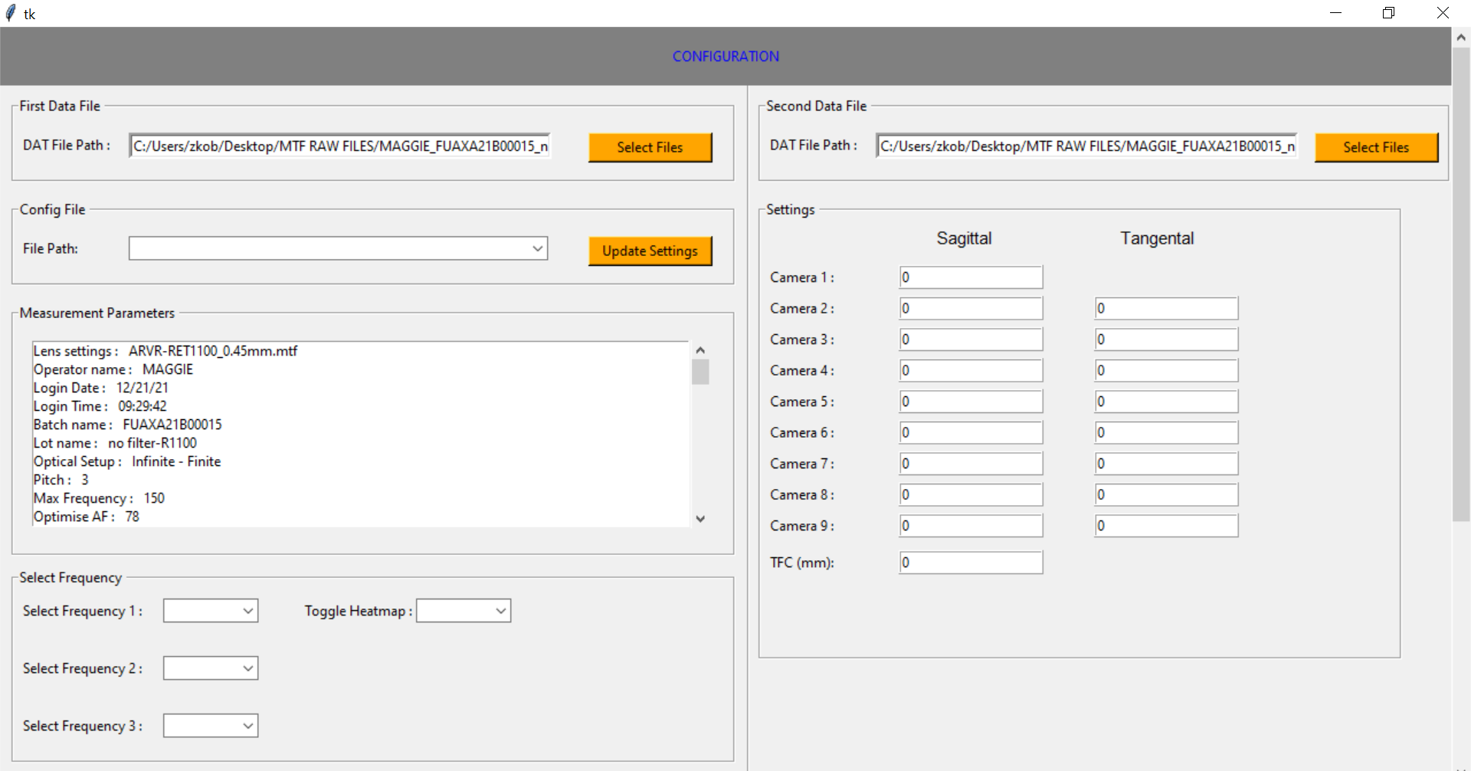
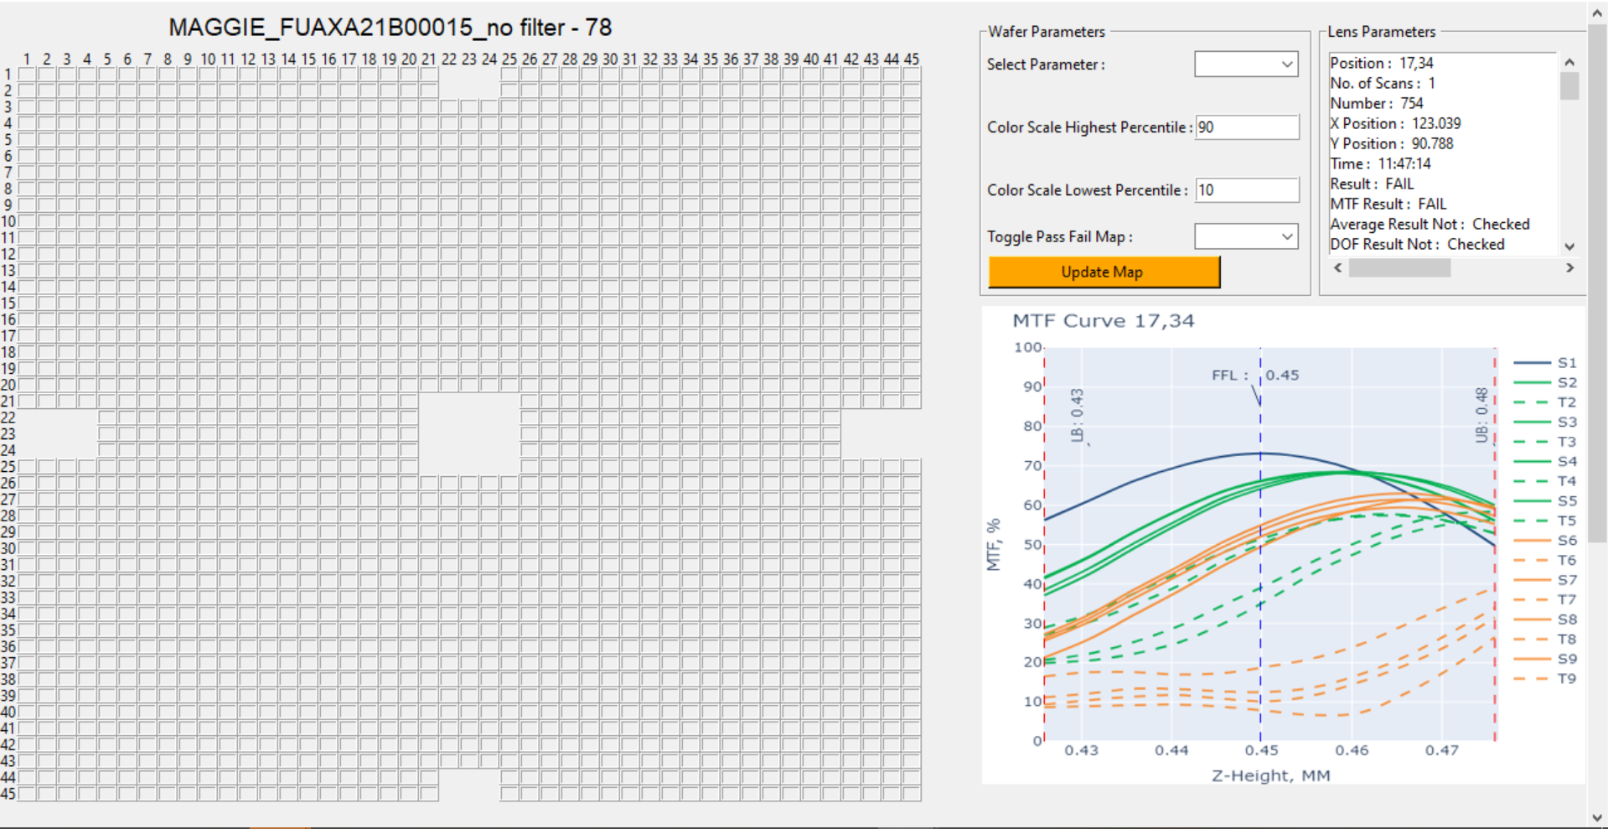
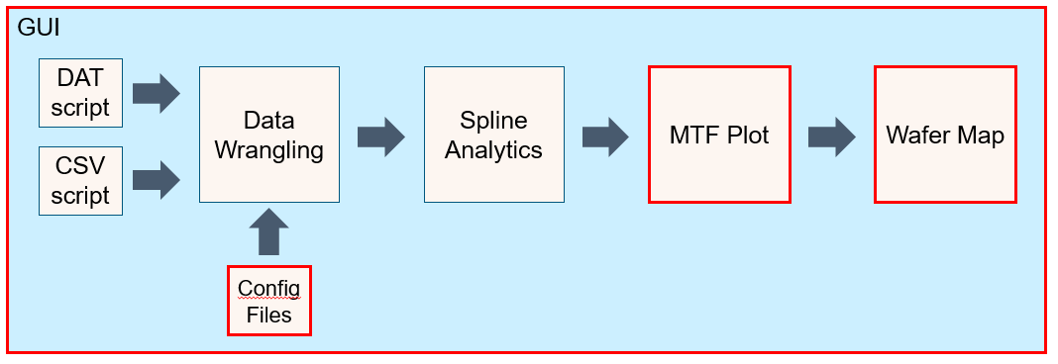
Projects Background
Main Project
MTF GUI Output
Main Project: MTF GUI
Objective
Create GUI presenting MTF data & curve of all lenses in Wafer
Problems:
No maintenance of VBA code
Need to analyze many wafers
Solutions:
Replace VBA GUI with Python GUI
MTF GUI Flow

Slide 5
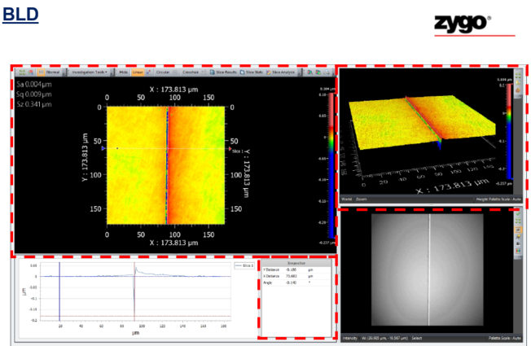
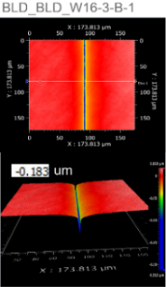
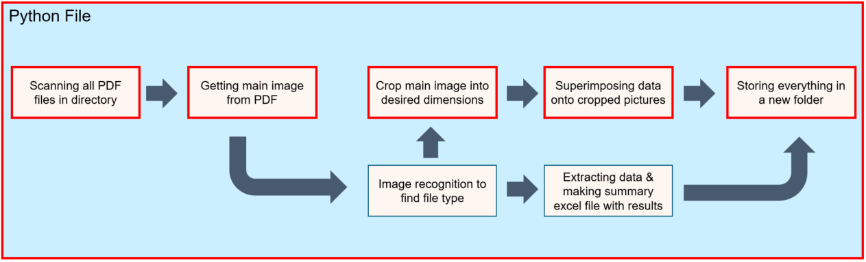
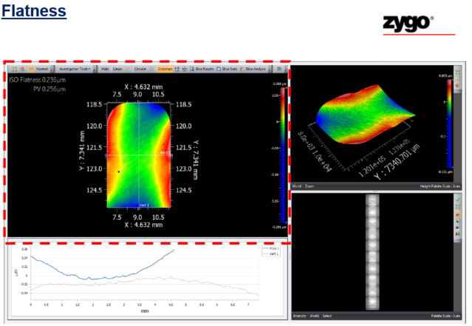
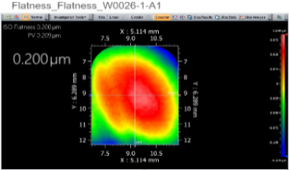
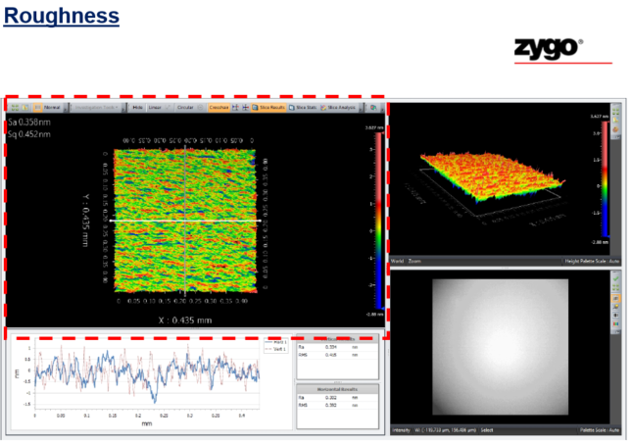
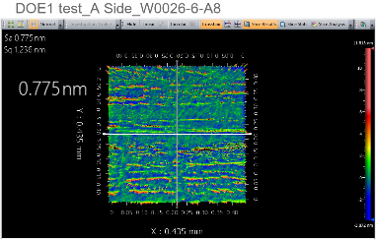
Projects Background
Supplementary Projects
Supplementary Projects
Script automating copying of processes for PCP & IQC Control Plan (Excel)
Python Script for processing of images from Zygo PDF files
Image Processing Output
3 Different file types
Extract Top & side view from BLD files & superimpose Y distance value
Extract the Top view image from flatness & roughness files & superimpose Iso & SA
Image Processing Script Flow
1
2
3

Slide 6
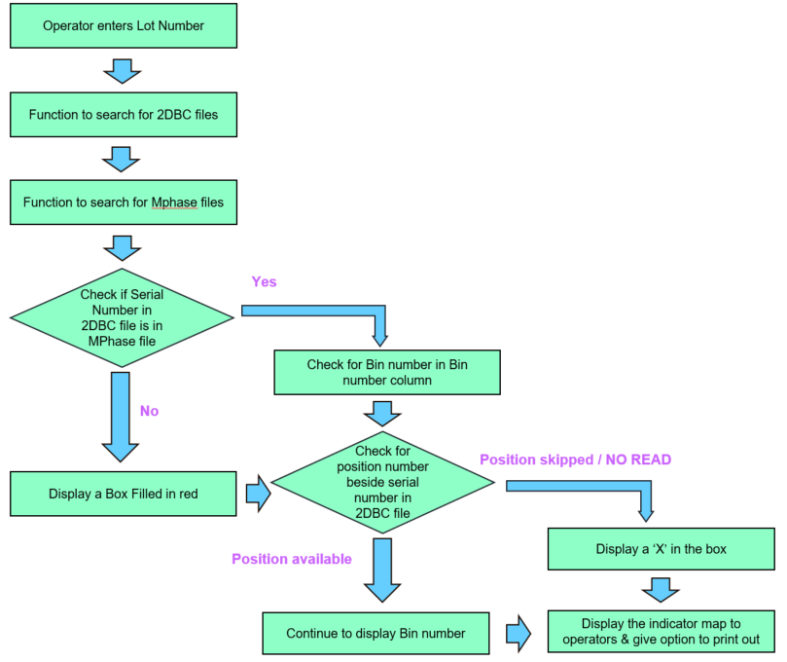
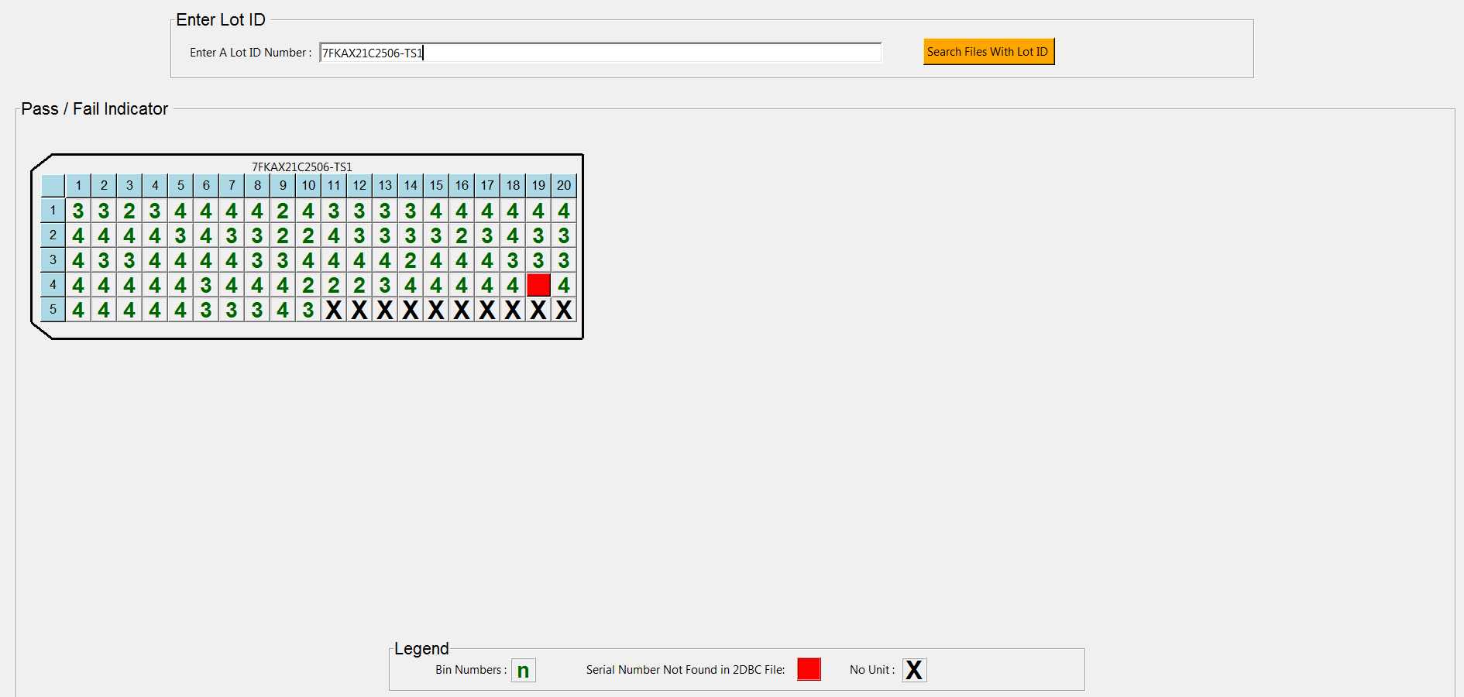
Projects Background
Supplementary Projects
Supplementary Projects
Python Script for Test Reject GUI → Compare serial number from 2DBC & Mphase Files → Display Bin number & units not found
Python Script for Angel wings form error plot
Test Reject GUI Script Flow
Test Reject GUI Output
Operator enters Lot number
Script searches for latest 2DBC & Mphase files
Checks if serial numbers in the 2DBC file is in the Mphase file & check bin number
Check for unit position to see if there is a unit present at specified position
Display a indicator map

Slide 7
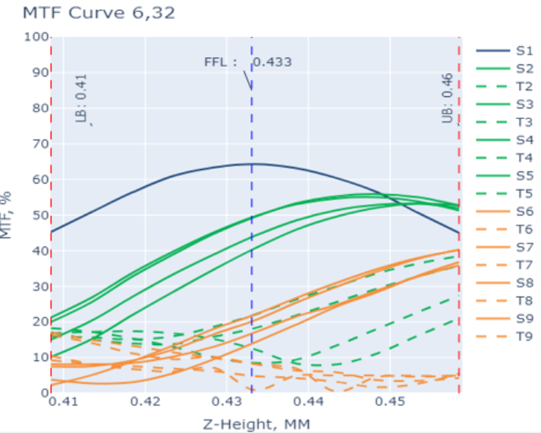
Deliverables
Main Tasks performed During Projects (MTF GUI , PDF image processing)
1
2
MTF GUI Project Tasks
Allow users to create new / load existing Config file
Open multiple Wafer Map windows (of diff. frequencies)
Toggle between Pass / Fail & contoured Wafer maps
PDF Image processing Project Tasks
Find out file types of PDF files based on images
Crop & superimpose images and info by file type
Place extracted images into a ‘Final Images’ folder

Slide 8
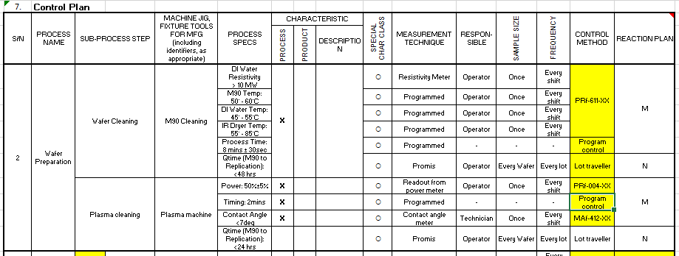
Deliverables
Main Tasks performed During Projects (PCP & IQC generator , Test Reject GUI)
3
4
PCP & IQC Generator Project Tasks
Find remark names & range of rows for remarks
Copy chosen remarks from selected worksheet
Completed plan exported to new control plan file
Test Reject GUI Project Tasks
Find latest Mphase & 2DBC files by given Lot Number
Display Bin Number for each unit unless not found
Display ‘X’ if ‘NO READ’ or no unit at position

Slide 9
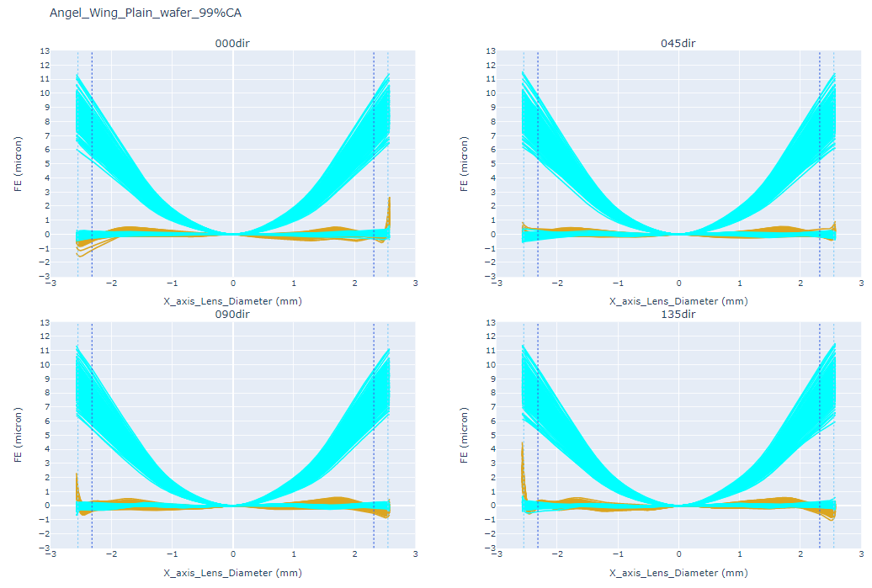
Deliverables
Main Tasks performed During Projects (Angel wings plot)
5
Angel wings Project Tasks
Plot graph by specific build (POC-C-II , Plain)
Color plotted graphs by direction and by FEC

Slide 10
Major Achievements, Challenges and Key Learning Points
Major Achievements throughout Internship
Major Achievements
Learned to apply Python algorithms
Learned VBA & Python Tkinter
Creating Python script for MTF , test reject GUI
Automating daily manual tasks (PCP & IQC , Image processing)
PCP & IQC : 99 % time saved (from 1 - 2 days to 10 - 15 mins)
Image processing : 40 % time saved per picture (from 60s to 36s) → On average user does about 50 pictures in 1.5 hours
PDF Image Processing Time Saved
Time saved: 44.6% (4 mins 50 sec)
Time saved: 57.7% (24 mins 30 sec)
Time saved: 65.7% (57 mins 30 sec)

Slide 11
Major Achievements, Challenges and Key Learning Points
Challenges & Key Learning Points throughout Internship
Challenges
Managing time taken for projects / tasks
Adapting to workload
Learning VBA
Key Learning Points
Important to keep backups of codes
Important not to hard code
Learned ways to reduce program speed
Reducing loops
Reducing Memory used
Learned to present & make documentation
Learned to plan & break down problems into smaller parts
Learned importance of having robust functions

Slide 12
Thank You

